Slide 1


Recording Video with OpenCV: A Practical Guide
Welcome to our comprehensive guide on video recording with OpenCV! In this presentation, we'll explore how to capture video from your camera and save it to your computer. This is a fundamental skill for anyone working with computer vision applications.
Building on our previous sessions about reading images and accessing camera feeds, we'll now learn the complete workflow for video recording - from setting up your camera to saving the final output. Let's dive into the practical aspects of video capture using Python and OpenCV.
by EMRE Akpınar

Slide 2

Setting Up Your Environment
Create a New File
Import OpenCV
Start by creating a new Python file in your preferred editor. Name it "video_recording.py" for organization purposes.
At the top of your file, import the OpenCV library with:
import cv2
This gives you access to all the video processing functions we'll need.
Initialize Camera Capture
Set up access to your webcam with:
cap = cv2.VideoCapture(0)
The parameter 0 typically refers to your built-in webcam. Use 1, 2, etc. for additional connected cameras.

Slide 3
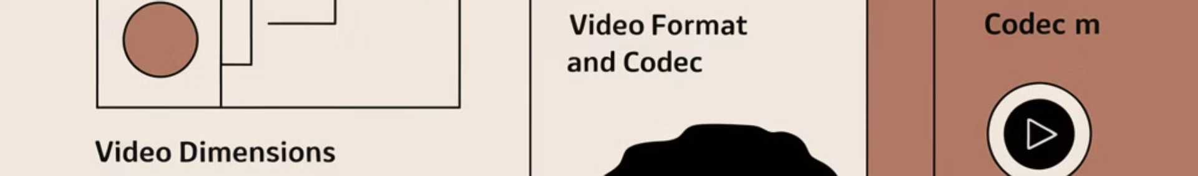



Configuring Video Parameters
Determine Video Dimensions
You can either set dimensions manually or extract them from the camera feed. To get dimensions dynamically, use OpenCV's property accessors:
width = int(cap.get(3)) # Width property
height = int(cap.get(4)) # Height property
Choose Video Format and Codec
Select an appropriate video format (like .avi or .mp4) and a codec for compression. The XVID codec works well for most purposes and is widely compatible.
Set Frame Rate
Choose a frame rate that balances quality and file size. Typical values are 24-30 frames per second for smooth playback.

Slide 4





Creating the VideoWriter Object
Specify Filename
Initialize Writer
2
Choose where to save the output file
Create a VideoWriter object to handle the saving process
1
Define Codec
3
Set video compression format
5
Set Resolution
Specify width and height for recording
4
Configure Frame Rate
Set frames per second (usually 24-30)
The VideoWriter class handles all aspects of saving video to a file. Here's how to initialize it:
writer = cv2.VideoWriter("recorded_video.avi",
cv2.VideoWriter_fourcc(*'XVID'),
24,
(width, height))

Slide 5
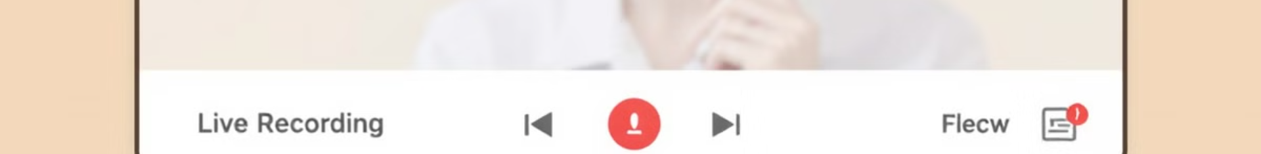
Recording Video Frames
Capture Frame
1
Read a single frame from the camera using
ret, frame = cap.read()
2
Check Frame Validity
Verify the frame was captured successfully with
where 'ret' is a boolean indicating success and 'frame' contains the image data.
if not ret: break
Write Frame to File
3
to exit the loop if the camera stops working.
Save the current frame to your video file using
writer.write(frame)
4
Display Preview
which adds the frame to your recording.
Show what's being recorded with
cv2.imshow("Recording", frame)
so you can monitor the recording process.

Slide 6
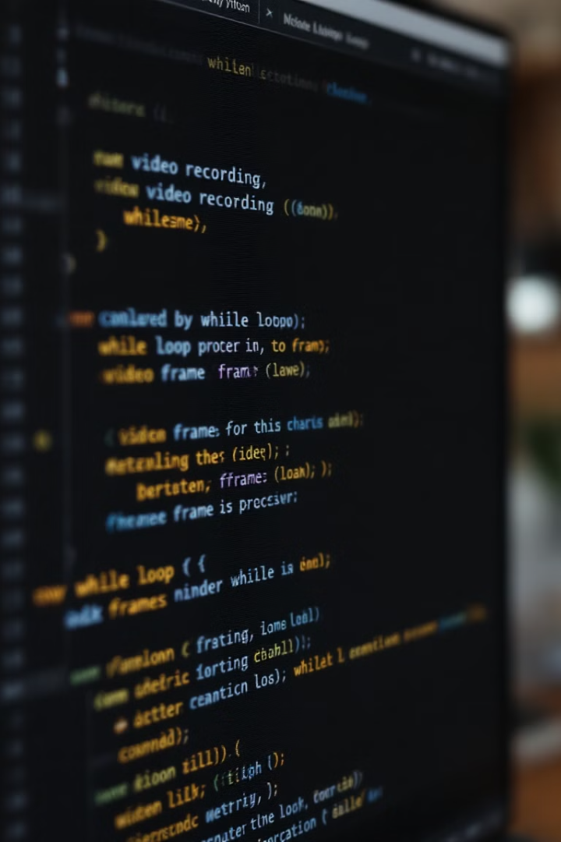
Implementing the Recording Loop
Create Infinite Loop
Set up a while loop that continues until manually stopped:
while True:
Process Each Frame
For each iteration, capture a frame, check its validity, save it to the video file, and display it.
Add Exit Condition
Include a way to stop recording when the user presses a key:
if cv2.waitKey(1) & 0xFF == ord('q'): break
The complete recording loop combines these elements to continuously capture frames until the user chooses to stop. The cv2.waitKey() function not only checks for keypresses but also gives the system time to process each frame properly.

Slide 7
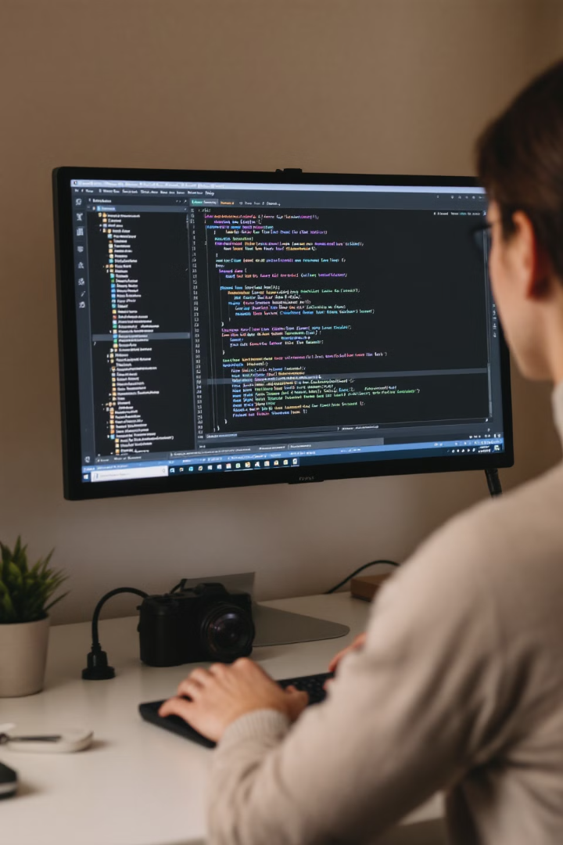
Properly Closing Resources
1
Release Camera Resource
Free up the camera for other applications using
cap.release()
. This is important as failing to release the camera can prevent other programs from accessing it.
2
Release Video Writer
Close the output file properly with
writer.release()
. This ensures all frames are saved correctly and the video file is properly finalized.
3
Close Display Windows
Remove any open OpenCV windows from the screen with
cv2.destroyAllWindows()
. This keeps your interface clean after recording ends.
4
Confirmation Message
Add a confirmation to let the user know recording completed:
print("Video recording completed successfully!")

Slide 8
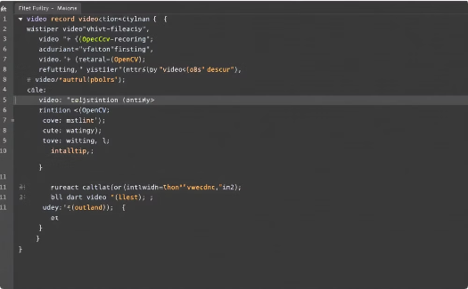
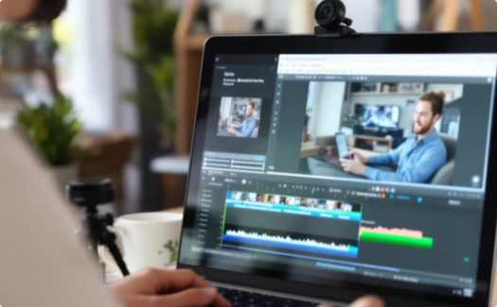

Complete Code and Next Steps
Complete Script
Verify Your Recording
Build Advanced Projects
The full implementation combines all the elements we've discussed: camera setup, VideoWriter creation, recording loop, and proper resource management.
After running your code, check the saved video file to ensure quality and completeness. This verification step helps identify any issues with resolution, frame rate, or encoding.
Now that you can record video, consider projects like motion detection, timelapse creation, or building a security camera system with automatic recording triggers.
Congratulations! You've learned how to capture and save video using OpenCV. This fundamental skill opens the door to countless computer vision applications, from creating custom video effects to implementing advanced surveillance systems.

